Slide 1
Global Mart sales performance analysis
By;
Moses Ogilo

Slide 2
Business understanding
Problem Statement.
GlobalMart is a fictional multinational retail company specializing in a variety of product categories, including Furniture, Office Supplies, and Technology. With operations spanning across multiple regions, GlobalMart strives to optimize its sales performance and profitability through data-driven decisions. This report analysis provides insights and relevant recommendations to improve on sales and profitability across all regions and product Categories.

Slide 3
Business understanding
GOALS;
Identify sales trends and patterns across all regions and product categories.
Identify Profitability trends across regions and year.
Evaluate regional performance to uncover opportunities and underperforming areas.
Analyze product performance to determine high-margin products and potential growth areas across the years and product categories.
Provide an Executive summary of sales and profitability trends across regions and product categories.
Provide actionable recommendations based on the findings

Slide 4
Data understanding
The dataset contains detailed information about GlobalMart’s sales, including: - Order Details: Order ID, Order Date, Ship Date. - Geographical Information: Region, State. - Product Information: Category, Sub-Category, Product Name. - Sales Metrics: Sales, Quantity, Discount, Profit.

Slide 5
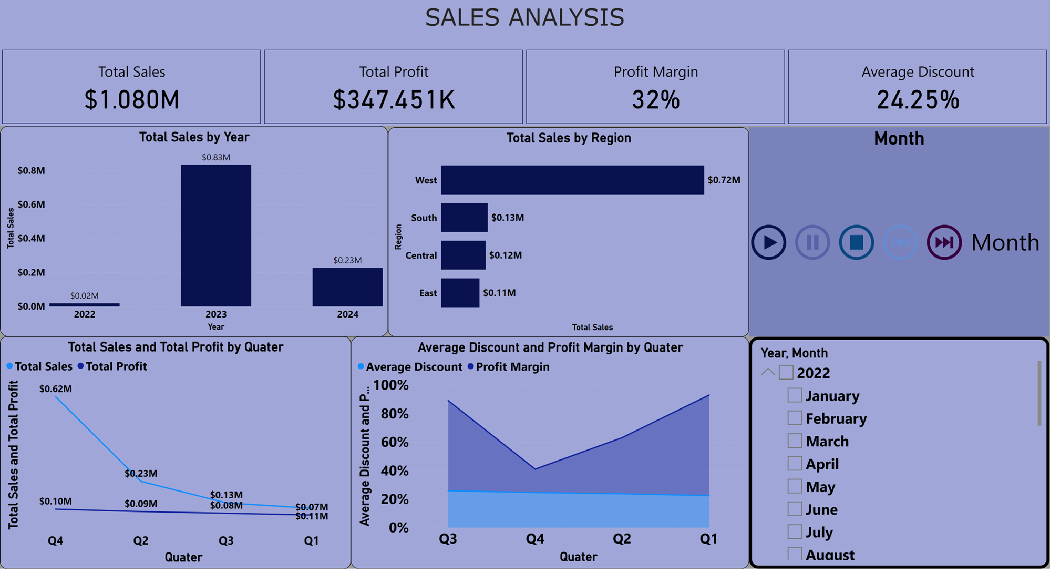
Sales analysis
Total sale for the period was $1.080M with the year 2023 recording the highest sale.
2. West region recorded the highest sale across the year and across the product category at an amount of $0.72M.
3. Q4 recorded the highest sale across the region with Q1 recording the lowest sale though profit gained remained relatively constant with slight changes.
4. Profit Margin deepen in Q4 , though average discount remained relatively the same across the years.

Slide 6
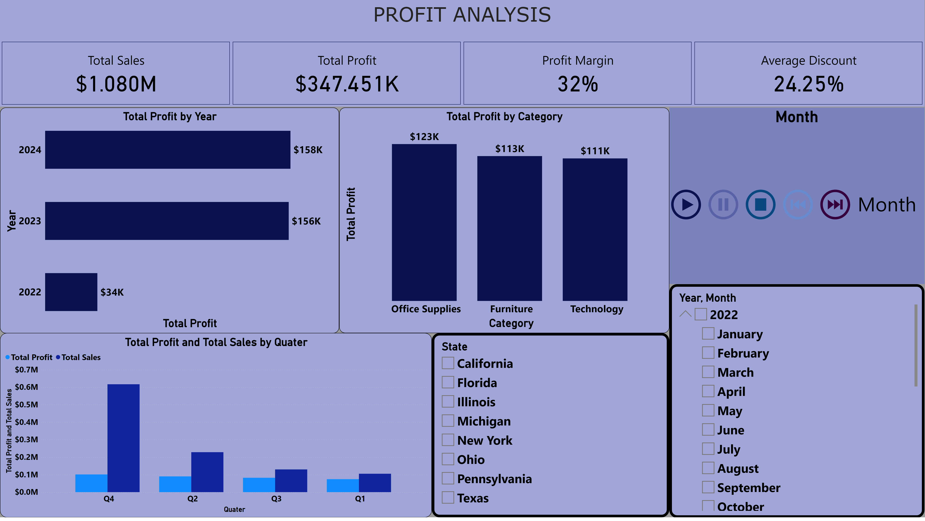
PROFIT ANALYSIS
Total profit recorded across the entire region and product category was $347.451K as the profit margin was 32%.
2. 2024 recorded the highest profit with Office supply gaining the highest within the product categories.
3. With Q4 recording the highest sale it also recorded the highest profit gained.
4. Q3 and Q4 didn't perfume well in terms of sales and profits.

Slide 7
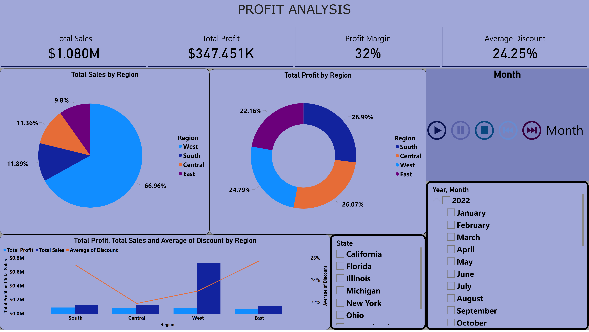
Regional analysis
1.West region had the highest sales recording relatively low profit which had lower sale during the period under review.
2. Soth region performed well and recorded the highest profit with relatively lower sale as compared to West.
3. East and South region recorded the highest discounts with relatively lower sales and profits.

Slide 8
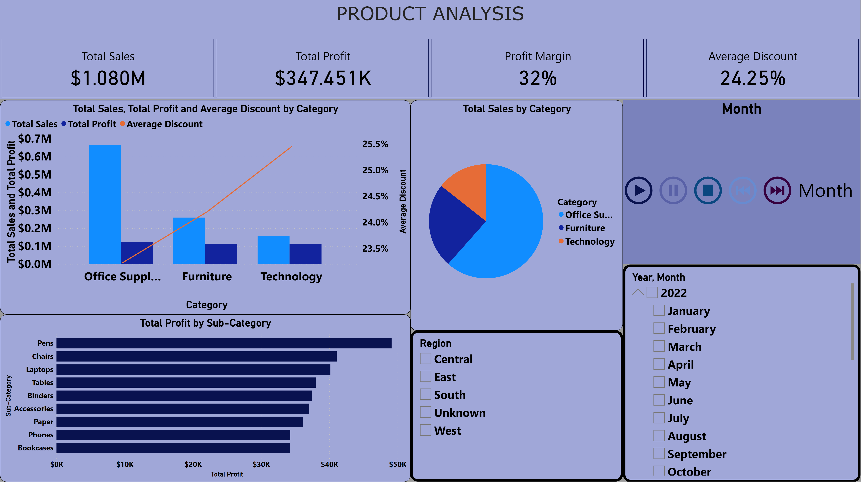
PRODUCT ANALYSIS
1.Office supplies had more sale across the region and years with relatively low discounts.
2. Within the sub categories Pens recorded the highest profit gained.
3. Technology had the lowest sales and profit gained with phones attracting lower profits.

Slide 9
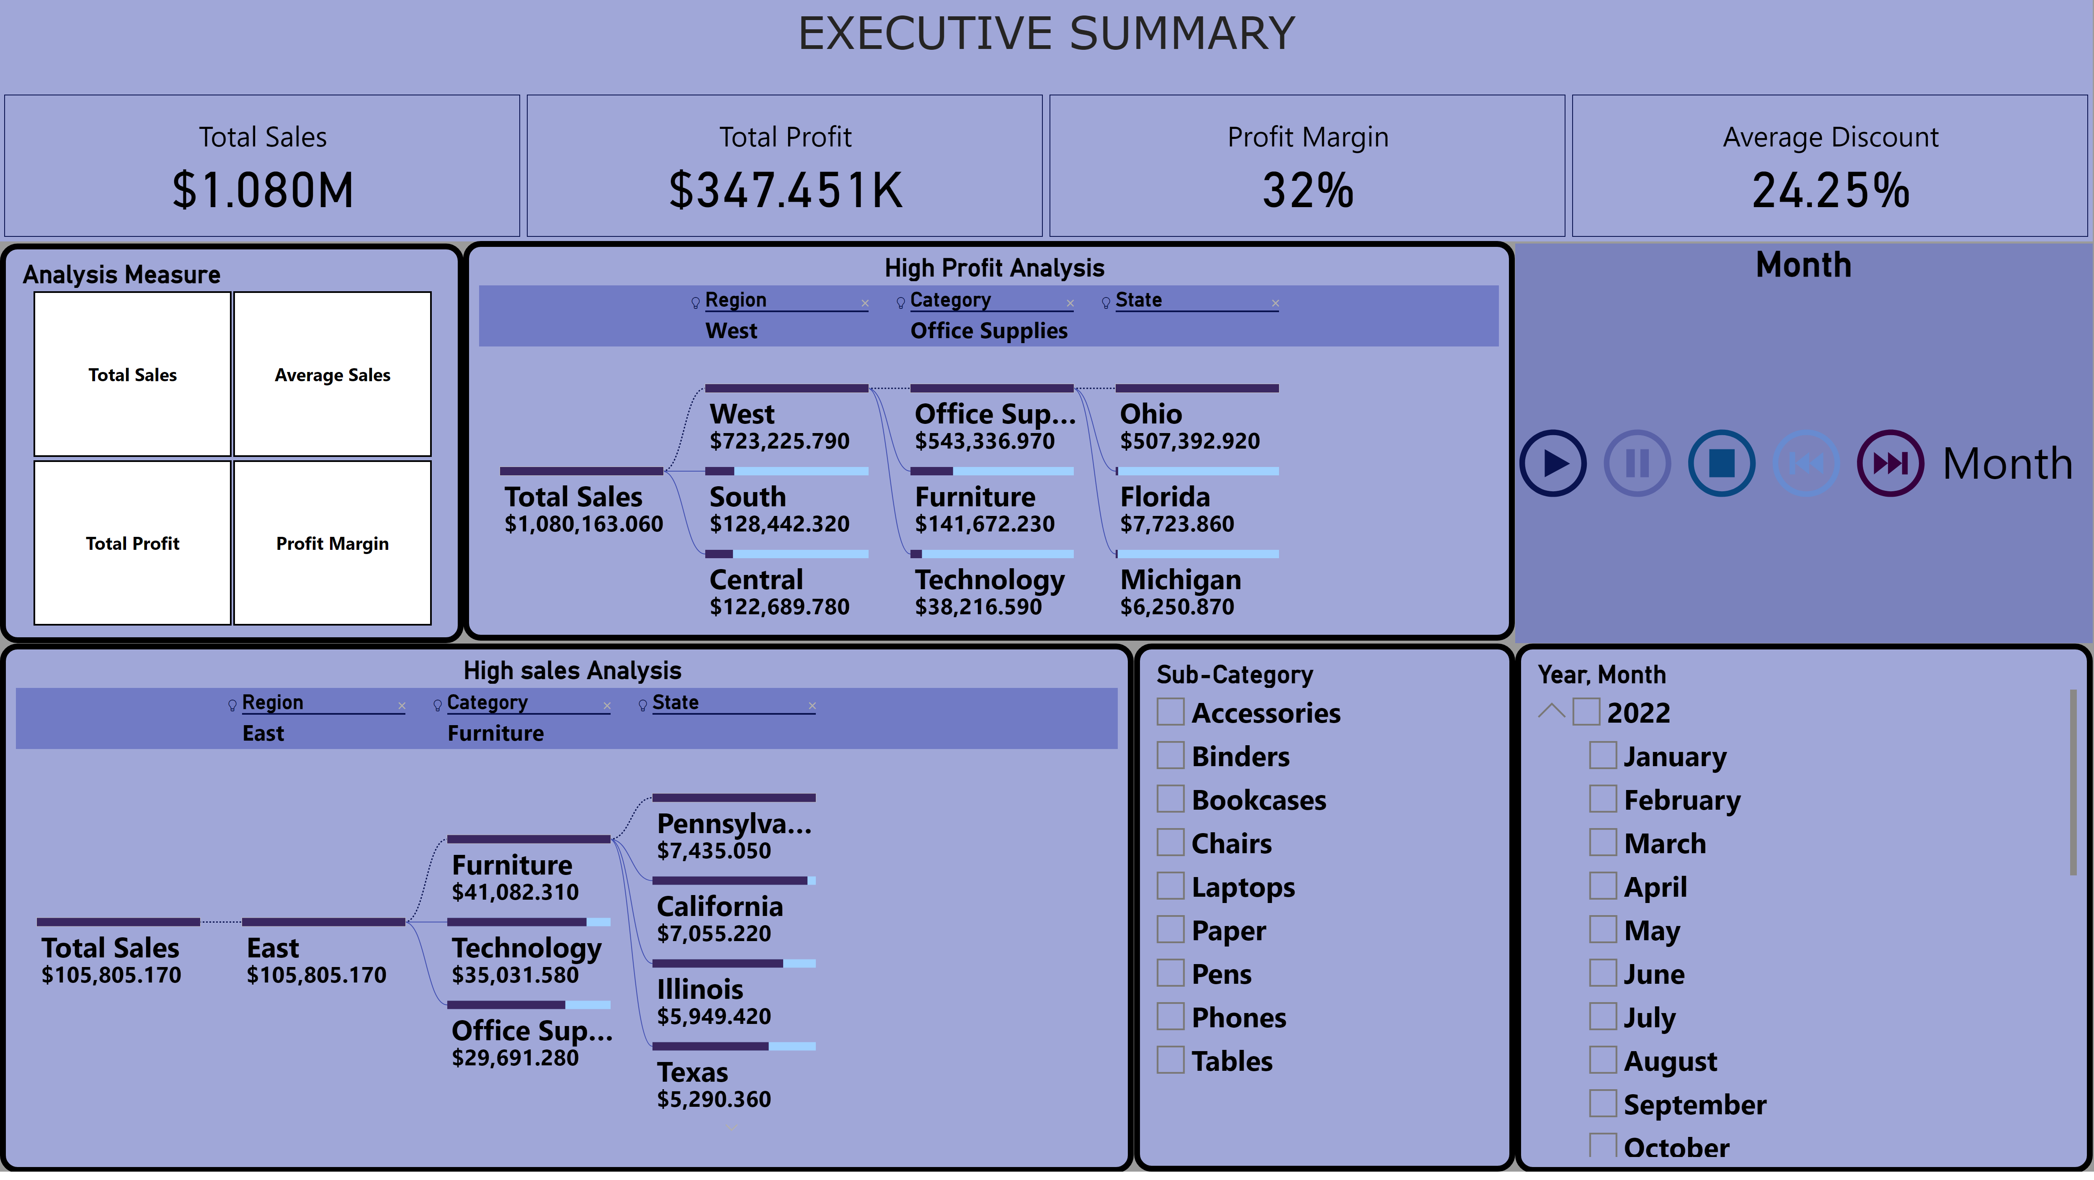
Executive Summary
1..West region had the highest sales with Office supplies selling highest in Ohio.
2.The highest profit gained was recorded within the South region, with Office supplies gaining more in Michigan.
3. 2024 was a good year with high sales and high profit gained.

Slide 10
CONCLUSIONS
-Sales Trends: The West region generates the highest revenue, but profit margins are lower compared to other regions while south region has high profit margins despite the lower sales as compared to West region.
-Product Performance: Technology products have the highest profitability, while Furniture has lower margins despite high sales and Office Supplies leads in both sales and profit. -Regional Analysis: The East region shows potential for growth but currently underperforms in terms of both sales and profit. South region excels in profit and orders despite lower sales compared to the West.
-Trends over time: December generates the highest sales compared to other months whereas January has highest profit margin.

Slide 11
recommendations
-Focus marketing efforts on high-margin products like Technology to maximize profitability. -Optimize inventory and reduce discounts for Furniture to improve profit margins. -Increase investment in the South region to unlock growth opportunities.
-Increase products manufactured during December since the sales are high during this period.
-Review discounts offered in December as it affects the profit margins, sales are high but profits are very low.
-Increase marketing in regions with high profit margin and low sales to boost overall performance.

Slide 12

Thank you

